Slide 1
Green University of Bangladesh
Department of Computer Science & Engineering
Subject: Microprocessors and microcontrollers
Course Code: CSE-304
Our Presentation topic : CAR Parking System.
Submitted To:
Name : Md. Atikuzzaman
Designation : Lecturer
Department : CSE
Green university of Bangladesh
Submitted by:
Name : Md.Nur A Neouse
ID :193002093
Name : Jakirul Islam
ID :193002101
Name :Nazifa Alam Nowrin
ID :193002103
Department : CSE

Slide 2
Content:
Introduction to our project
Objective
Planning of the project
Features of our project
Project Function
Simulation Procedure
Output
Future Scope
Conclusion

Slide 3
Introduction to our project
The smart parking system implemented mainly in Europe, the United States, and Japan are developed with the incorporation of advanced technologies and researches from various academic disciplines. With its deployment in the car park, it is hoped that it would solve the aforementioned problems faced by the patrons within the car park.

Slide 4
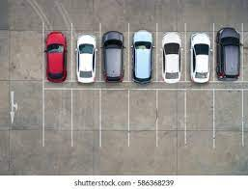
Objective
1. To create smart parking system
2. To calculate total capacity
3. To give services at a low cost

Slide 5
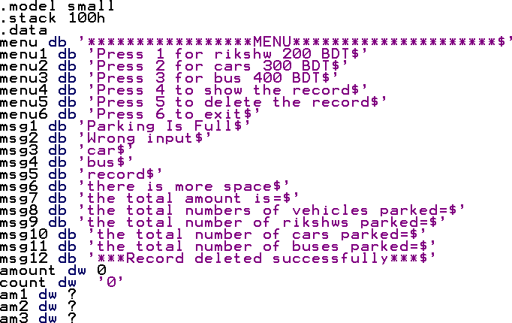
Planning of the project :

Slide 6
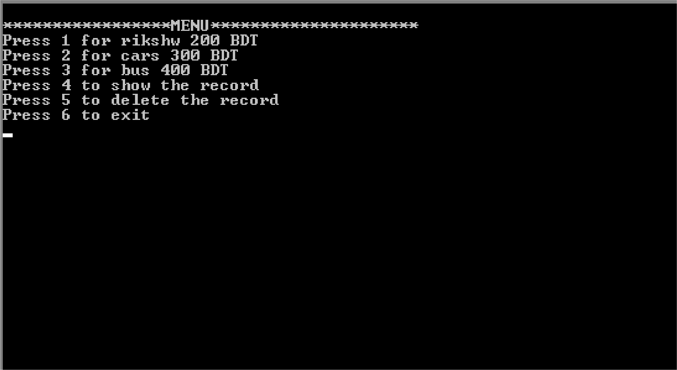
Features of our project

Slide 7
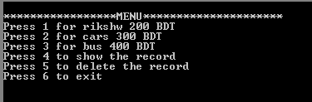
Project Function

Slide 8
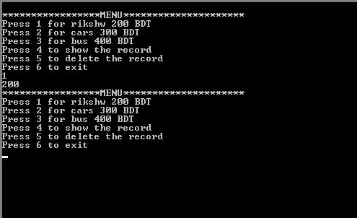
Project Features
PARKING MENU & COST

Slide 9
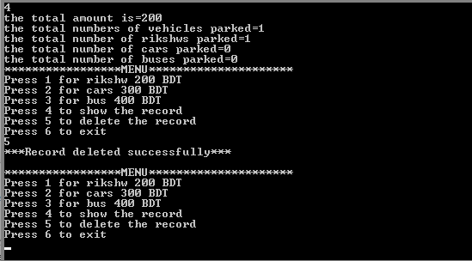
Project Features
DELETE THE RECORDS

Slide 10
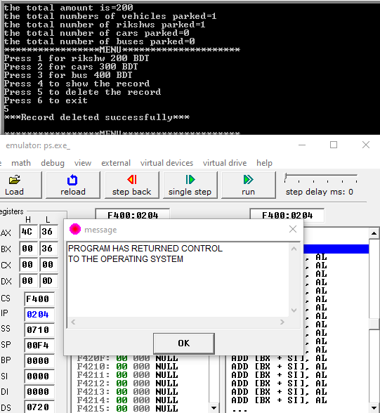
Project Features
Exit

Slide 11
Simulation Procedure
emu8086 software.
Assembly language : x86
Used a stack
Operating system : Windows

Slide 12
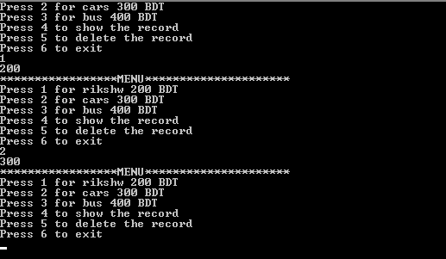
Output

Slide 13
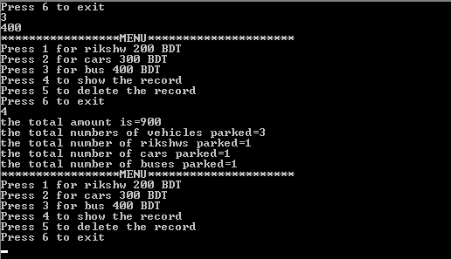
Output

Slide 14


Slide 15
Conclusion
The report clearly demonstrates the way the 3 level parking controller system was implemented. It was also highly beneficial as it gave us an insightful view of how advanced smart parking systems are programmed in order to be used in embedded systems later on.

Slide 16
Thank You

